Slide 1
Estate Planning:
The Future of Your Family
Insert wholesaler name
Notes:
Good [morning/afternoon/evening]
Thank you for coming. I’m [Name] with BMO Global Asset Management, and I’ve been working with your advisor for ……
[Feel free to add as much about yourself and your team as you wish.]

Slide 2
This presentation is for educational purposes only and does not constitute investment, legal, accounting, tax advice or a recommendation to buy, sell or hold a security.
Our employees and/or financial advisors are not estate planners and cannot provide tax or legal advice. You should consult your estate-planning professional or qualified tax professional regarding your situation.

Slide 3
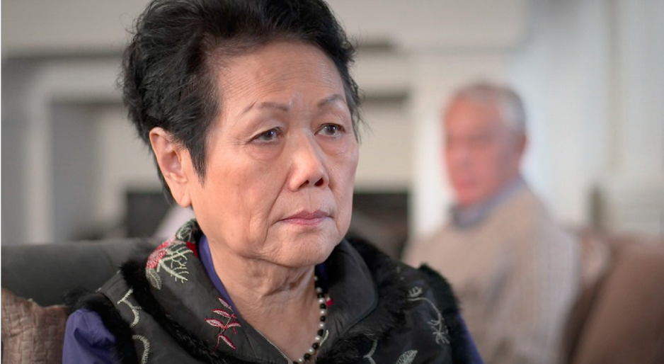
Katherine’s Story
Notes:
I would like to start with a video that highlights one of the key elements of estate planning.
---------------------------------------------------
Show Katherine video: https://vimeo.com/370120866
As this video shows, Estate Planning isn’t just about end of life. Complex issues that require advance planning, can arise and continue for a long time before death.
If we look at the issue of Alzheimer’s disease like Katherine had, we know that in Canada right now at age 65, about 1 out of 11 persons has dementia including Alzheimer’s disease.
When you get to 85, it affects about 1 out of 3 persons.
And someone with dementia can live with it for 10, 15, even 20 years.
Without the proper things in place, it is very difficult for family members to act or to know if they are acting in accordance with what their loved one would have wanted.
Possible long-term family strife can arise because essential conversations were not had when all family members were healthy.
A good estate plan can prevent issues like these from happening. And that’s what we will cover today.

Slide 4
Today’s agenda
What is estate planning in the 21st century
Key elements of estate planning
Estate planning strategies and tools
Notes:
For today’s presentation, we will talk about:
-What is estate planning in the 21st century
we will discuss not only the importance of having an estate plan,
but also why is it an urgent item that should be a priority no matter what stage you are in your life
-We’ll then focus on some key elements of estate planning, and
-Look at some estate planning strategies and tools, to help you create your future with a good estate plan

Slide 5
What does Estate Planning in the 21st Century look like?
Wills
Economic Interests
Business interests
Passing on your wealth
Tax planning
Asset protection
Personal Wishes
Organ donation
End-of-life care
Items of personal effect (sentimental value)
Charitable interests
Family Dynamics
Trusts for beneficiaries with special needs
Caring for family members
Pets
Digital Assets & Online Legacy
Reward points
Patents
Crypto-currency
Email and Social media accounts
POAs
Notes:
Most people think estate planning means having a Will. While this is an important cornerstone, Powers of Attorney are equally important, as we saw in Katherine’s story. And, as you can see here on the slide, estate planning is more than just having these documents- it’s optimizing and navigating across a range of elements.
The 21st century is being rapidly transformed by an ever-evolving digital realm, an aging population, that is living longer and issues that are sometimes forgotten or assumed to take care of themselves. By recognizing these changes and issues and working with an estate-professional, you can take positive action to put in place a well thought out estate plan.
Family dynamics – second marriages, blended families, emotionally-charged assets such as a family cottage are all to be taken into account and open communication is best, or else your heirs may misunderstand your intentions and could lead to family conflict.
Caring for elders – some individuals in the “sandwich” generation are providing financial support to their parents and children or grandchildren so their estate plans must reflect this, who will continue to provide care to those dependent on you if you are not around to provide the support?
Pets- most would agree that our pets have become one of the family, what happens to you pets if your not around, unfortunately most pets are sent to the shelter when plans are not made or communicated.
Business interests – your business succession plan and your estate plan need to work together, and you may need to provide for post-mortem tax planning. What’s the best way to protect and pass on your assets to your family.
Personal wishes- If you want to give money in a charitable interest, how do you want this is set up.
Digital assets – in addition to e-mail and social media accounts (Facebook, LinkedIn, Twitter), some digital assets have value such as Bitcoin accounts, Rewards points like Airmiles
Managing the number of moving parts in estate planning today can be a daunting task. We hope that in our presentation today, we will present our approach to make the process more coherent

Slide 6

Wills and POA: Cornerstone to your estate plan
Why important?
  No Will
  Estate may not be distributed as you wish
  Administrative mess
  Expensive
  No POA
  No one may know how to manage your finances
  You may not have your wishes carried out-not
  just end of life
Can cause issues that reverberate generations!
Notes:
Wills and POA are the cornerstone of your estate plan!
So when we talk about the Will, obviously not having a Will means that a your estate may not be distributed as you wish and we can certainly talk about the administrative mess that can be left behind depending on how complex the person’s situation is. And, it can be an expensive process if it is not thoughtfully planned. There is always that messy possibility of a dispute between family.
Not having powers of attorney, can impact your family as we just saw in Katherine’s story. And keep in mind that powers of attorney are not for the end of life. Accidents can happen and you may be incapacitated for a period of time before recovering. Or, like Katherine, you may live with a condition that impacts your ability to manage your own affairs for a number of years. With POAs you are able to appoint someone to act on your behalf to manage your finances or make health and personal care decisions.
And not having a will and a power of attorney may not just be a current problem, these things can reverberate for generations when families have issues around their parents wills and powers of attorney. Okay, so I’m going to guess that all of us are on the same page now- Will and POA are the cornerstone of your estate plan.

Slide 7

“Planning is bringing
the future into the present so that you can do something about it now.”
Alan Lakein
Personal time management author
Notes:
This is a great quote- “Planning is bringing the future into the present so that you can do something about it now” and for Estate Planning this is very important, in order to leave a lasting legacy that distributes your assets according to your wishes, a well thought out estate plan is needed, and so you need to prepare today for that tomorrow.

Slide 8

Why don’t people complete these documents?
  Fear/superstition- The idea of death is a hurdle
  Don’t recognize implications of not having them
  Avoid difficult conversations
  Procrastination
  How can your estate professional help:
  Educate
Set realistic goals
  Simplify the complexity
Notes:
We know that having a Will and POAs are important, then why do so many people not have these documents if they are so important?”
Wills and POAs are important but not urgent – until something happens
[AUDIENCE QUESTION]
what creates urgency for people to get these done?
…death of someone they know, a diagnosis – theirs or someone else’s,
----------------------------------------------------
One of things that we hear a lot about is: fear and superstition get in the way of doing the documents and what I mean by that is people have a fear that if they do them, it’s going to mean they die and so this is one of the things that we have to overcome.
1. I always say to them that, you know, I guarantee to you doing the documents will not kill you and people always laugh about that, but the thing I do say is even though you have that fear, you have to move through it.
2. The other thing, is people don’t recognize the importance of having documents and they don’t recognize the implications of not having them and this is where your advisor can help you and empower you with the knowledge. The reason I am here today is so you all know how important estate planning is.
3. And then the third thing is, putting together estate plan also means having some serious conversations with your family and we all like to avoid this.
4. Fourth, people don’t see this as urgent, so we procrastinate. People may see it as important, but they don’t see it as urgent. A good strategy to get past this is rather than scheduling a task for completing your estate plan, schedule time. Be it an hour a week for the next few weeks to sit down with your advisor to get the ball rolling.
Work with your advisor, lawyer, and tax consultant to work through the practicalities of getting these documents done.
------------------------------------------

Slide 9

Katherine’s Story
Key elements of estate planning:
an effective estate
plans start with…
Notes:
Let’s now focus on the key elements of estate planning, and so the most effective estate plans start with…

Slide 10
Determining Your Objectives:
Achieve
Preserve
Avoid
“I want to ensure my spouse is looked after”
“I want to protect the family cottage that has
been passed down through generations”
“I want to avoid disputes among my family members”
Notes:
Determining your objectives.
Rather than focussing on what you own, consider asking yourself the bigger question: What do I want what I have to achieve? Determining your objectives for your wealth can begin by asking 3 supporting questions:
What do I want to achieve?
What do I want to preserve?
What do I want to avoid?

Slide 11

Once you have set and understood your goals, determine:
Who do you want to benefit? List your beneficiaries:
        Family
        Friends
        Charities
determine how much and when
consider your personal circumstances,
(e.g., are you in a second marriage?)
identify beneficiary issues, such as special
needs or unstable marriages etc.
determine best way to provide for them
Notes:
Once you have your goals, then start determining who do you want to benefit and what’s the best way to provide for that.
- When identifying your beneficiaries (friends, family members), consider the possibility that one may predecease you. What is to happen to his or her share?
In addition to making a positive impact on issues that are important to you, donations to registered charities can provide your estate with enhanced income tax savings
Except for more modest cash gifts, consider what proportion of your overall estate you want each beneficiary to receive and identify an appropriate share, rather than a fixed dollar amount
Trusts are required for minors but can also be used to provide protection for disabled persons or others who are vulnerable due to addiction or other mental health issues
Trusts can also play an important role in second marriages

Slide 12
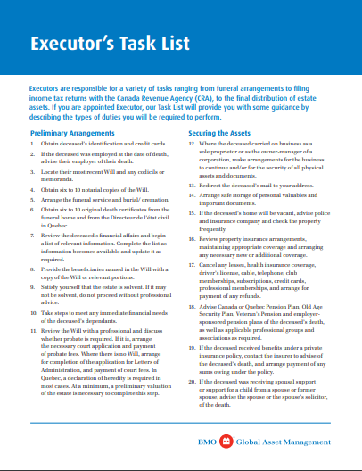
Choosing the Right Executor
Executors are responsible for a variety of tasks ranging from funeral arrangements to filing income tax returns with CRA, to the final distribution of the estate assets.
  availability
  financial accountability
  trustworthiness
  good judgment
  impartiality
  longevity and continuity
  risk management
Notes:
[Bring Executor’s task list to distribute: https://bmogamhub.com/system/files/executortasklist_estateplanning_eng.pdf?file=1&type=node&id=33309]
-Choosing the right executor (or “liquidator” in Quebec) is an important step in meeting your objective to preserve the value of your estate after death.
-The role comes with potential personal liability if the duties are not adequately performed. As a Trustee, an Executor is held to the highest duty of care – a “fiduciary duty”. In order to discharge his or her duties, the Executor has not only to have the necessary skills but also to be available to complete the administrative tasks in a timely manner. When an active business is involved, choosing the right Executor to oversee the transition of the business is critical. In order to meet your objective of preserving family harmony, he or she has to show many of the personal qualities set out above. And finally, he or she has to be there to act when the time comes and to administer any trusts that may last a number of years. Someone who lives out of the country or even out of the Province is rarely a wise choice.

Slide 13

Completing your Wills and POAs
  Prioritize completing your Wills and POAs!
Difference
  Wills – providing for others when you
  are gone
  POAs – providing for your care if you should become incapable
  Financial vs. personal care POA
Revisit often
  These are part of your overall
  financial strategy
  Revisit at least as often as there
  is a change in relationship
Notes:
Once you have your objectives, who you want to benefit, and how you want to do it, then it’s time to formalize it by putting it all on paper.
Your Will and POAs are legal documents so it is important that they are done properly. Working with a lawyer helps ensures this. The most important thing is to get the documents done, and revisit these often. Otherwise your wishes may not be acted upon.
Completing your Will and POAs should be a financial priority for everyone, regardless of how large or small your estate.
Your Will is something that you have to provide for others when you’re gone, but the powers of attorney are all about you and making sure you’re okay while you’re still here. And you need to keep them updated.
[AUDIENCE QUESTION]
When was the last time those of you who have a will updated it?
How many more than 10 years, how many more than 15 years?
Many people do wills when their kids are little and they never update them again. Revisit your Will at least as often as when there’s a change in a relationship, whether it’s a marriage, a birth, a death, a divorce, whatever that change is should trigger you to look again at your Will.

Slide 14

Essential Conversations
  Essential Conversations:
Talking to the most important people
about the most important things in our lives.
Notes:
So having the documents is clearly important, but there’s a whole other aspect to this which is having essential conversations about what’s important to you and what you want to see happen.
What I want to do is share with you now a video of a family that’s dealing with the aftermath of their father’s death and then I’ll talk about this a little bit more.

Slide 15
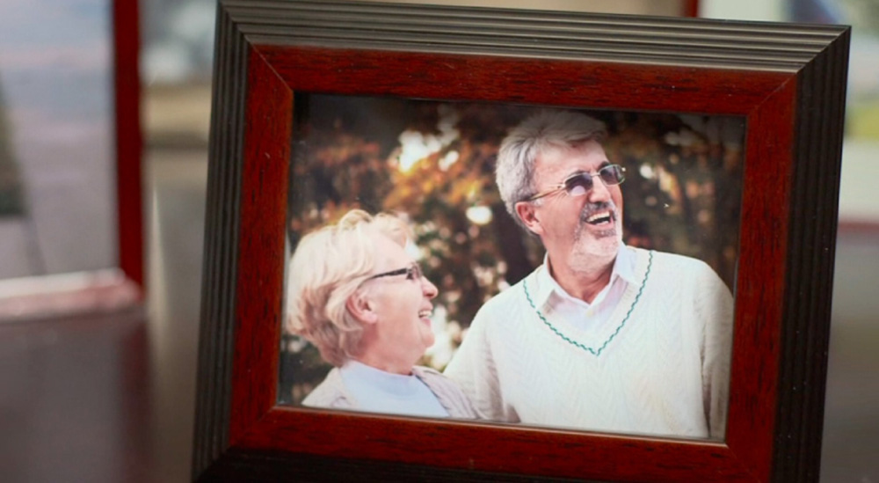

Peter’s Will
Notes:
Show Peter video: https://vimeo.com/370179733
[AUDIENCE QUESTION]
what are the issues that come out in this video? (have them call out)
Issues of division of money – easily could have been discussed
Issues of possessions that don’t have monetary value
Issue about where the money is left to honor their mother and what they would have preferred
What could have prevented this? NEXT SLIDE

Slide 16

ESSENTIAL CONVERSATIONS
Notes:
I think this video is such a great example of how having the documents completed, but not having had conversations can still leave behind a mess. So there were really 3 issues that you can hear that the kids were grappling with after their dad died.
1. One of them was around the division of money and, you know, the daughter was pretty clear here that she understood that the reason her brother was getting more money was because she made more than he did and he had kids and she didn’t have kids, but then she said the line at the end that’s so key when she said, “parents have their favorites”.
And, your advisor can tell you from having worked with many families, at some point when kids are in their 40s, 50s or 60s, it is not uncommon for one of them say “I knew mom loved you best” and in this case it’s “I wonder if dad loved you best”. Had Peter just talked to the kids and explained it, there’s a great example where I think they would have been fine with it. The daughter didn’t have an issue the brother got more money, she just wondered.
2. The second issue is about the painting. In this case it’s something without a great deal of monetary value, but it has a lot of sentimental attachment for both Peter’s children.
Things that have sentimental or emotional value are sometimes not top of mind when people are putting their estate plan together. Estate planning is not only about financial assets. Estate lawyers have told me over and over that the sentimental things are often the things that hang up families when the Will is read.
3. And then the third issue that Peter left behind inadvertently, was the issue about his wife’s memory and leaving the money to the hospital and the kids would have just loved an opportunity to be able to weigh in on that. Now Peter might have still said hey, I hear you, but I want to leave the money here. A conversation with the kids would have resolved so many of these issues and it would not have been that difficult a conversation, but most people don’t think to have them.
-------------------------
So, have the ESSENTIAL CONVERSATIONS!
Discuss your wishes, and the thoughts behind those wishes, with all the people who are involved, impacted, or could be problematic at time of enactment.
Not having completed the documents AND having the conversations in advance can leave behind a mess that can reverberate generations.

Slide 17





Process for Essential Conversations
Focus the
conversation
Share
information
Allow people to respond, react, ask questions
Create
a to-do list
Schedule a follow-up
conversation
Notes:
[Bring BMO Family Meeting Guides to distribute: https://bmogamhub.com/system/files/estateplanningfamilymeetingguide_e_gam.pdf?file=1&type=node&id=95484]
So here’s the process that you can use for having essential conversations.
1. First of all, I suggest that you focus the conversation and what I mean is that I know when families get together and start talking about things, they often turn into what I call kitchen sink conversations, people throw everything in. So I suggest what you do is really focus in on what the topic is going to be and then if stuff comes up, you can record it and say look, we’ll come back and talk about this at another time. This doesn’t have to be formal, it’s just a way to make sure that the issues that come up don’t get lost and people feel again that they’re heard, but at the same time that you keep the conversation focused.
2. Next share information - talk about what will be in your Will, your Powers of Attorney, and about who you would like to be the executor. Give people time to respond, react and ask questions. This is where obviously it can get out of hand, but if it’s done in a way that people understand that they are going to have an opportunity to be heard, I have found that people are a lot calmer than they are when dealing with this in a crisis or a very difficult time.
3. Recognize that everybody processes information differently. You may have people in the discussion who are able to process things, think about it and respond quickly. Other people are going to need more time and hence schedule a follow-up conversation. This gives people the opportunity to think about what you’ve shared and come back with questions without feeling pressured to react immediately.
4. The fourth step in this is to create a to-do list for anything that requires further action as a result of the conversation. There may be some things you want to change now in order to facilitate what you want later. By listing the key things that need to be done, you can help ensure that they are not forgotten or set aside.
5. And then the last step and this is to schedule the follow-up conversation. This allows you to share with your loved ones what actions you have taken, reiterate your wishes and your thinking behind them. Essential conversations are rarely a one and done conversation. As life changes, it is helpful to revisit the key things that are important to you with those you love.

Slide 18

Estate planning strategies

Slide 19

Consider how your assets are currently structured
Outright gifts during life
Are you supporting anyone financially?
How are your assets registered?
Joint tenancy? Partnership?
Trusts
Beneficiary Designations
Corporate structures, shareholder agreements
Notes:
[Opportunity for product tie in here]
e.g. Seg Fund info from BMO Insurance:
GIF Client Guide: https://www.bmo.com/advisor/PDFs/bmo-gif-client-guide-595e.pdf
----------------------------------------------------------------------------------
Once you have determined your objectives for your estate plan, and who and how you want to benefit them, now it is time to look at not only what you own, but how you own it.
Have you advanced money to family members? Was it by way of a gift or is it a loan? Is it clear which? How (or will) you account for it on death?
If you are supporting someone during your lifetime, you may have a legal obligation to provide for them after death.
Do you own assets jointly with another person? What are your intentions for these assets on death and does the registration support that? Who will pay the tax?
If you have a Family Trust, understand that the assets of the Family Trust will be distributed according to the Trust Deed and not your Will. Are these co-ordinated?
Have you designated someone as a beneficiary on life insurance policies or registered assets? (The latter does not apply in Quebec). Is this consistent with your objectives?
Do you own shares in a corporation and if so, are they subject to a Shareholders’ Agreement that sets out what is to happen on death?

Slide 20

Taxation at Death
Canada has no “estate tax”
“deemed disposition” at death / RSPs fully taxed as income
        spousal rollover
        principal residence exemption
        post-mortem planning for corporations
        planned charitable giving
Notes:
- Unlike some European jurisdictions or the United States, Canada has no Estate Tax “per se” on the value of the overall estate at death.
Instead, all registered tax-deferred assets (RRSPs, RRIFs) will be fully taxed as income in the year of death and all capital assets will be deemed to have been “sold” at fair market value as at the date of your death. Accumulated net capital gains will be then be taxable on your final return.
Exceptions include assets passing directly to a spouse (or a qualifying testamentary spousal trust) or to a financially dependent minor or disabled adult child, when a “rollover” of the assets at cost is available
Another exemption is the capital gains exemption for a principal residence
Making charitable donations by transferring appreciated securities will provide enhanced tax savings
Properly drafted estate documents will also give Executors the necessary powers to do “post mortem” tax planning, especially for private corporations

Slide 21
Review
Review your estate plan with an estate professional for gaps between your goals and your structure and identify opportunities for:
tax planning
probate planning
income splitting
use of trusts
charitable donations
Insurance
  an efficient way to leave an estate
  protection for your estate plan
Gaps
You
Your goals
Opportunities
Notes:
[Opportunity for product tie in here]
e.g. Seg Fund info from BMO Insurance:
GIF Client Guide: https://www.bmo.com/advisor/PDFs/bmo-gif-client-guide-595e.pdf
---------------------------------------------------------------------------
This is the stage at which an experienced estate planner can add particular value. Rather than just transcribing your wishes into a legal document, an expert in estate planning will review your objectives and intentions in light of your assets and the manner in which you own them. He or she will also take into account what other documents may play a role in how the assets will be dealt with at the time of your incapacity or death e.g. domestic contracts, partnership or shareholder agreements, Family Trusts. Using that information, he or she will provide valuable insight into how these strategies (Tax planning, probate planning, income splitting etc.) can be utilised to maximise what you want to achieve, minimize what you want to avoid, and protect what you want to preserve.

Slide 22
Estate planning involves navigating a web…
Family Dynamics
End-of-life care
Your Will
Income tax planning
Probate
Planning
Caring for dependents
Organ donation
Inter Vivos
Trust & Planning
Estate planning
RSP/RIF designations
Pets
Items of personal effects
Powers of
Attorney
Life insurance
designations
Dependents Relief
Legislation
Property registration
Bequests & Charitable giving
Online Legacy
Notes:
A well thought out estate plan involves navigating a web to address many issues and fulfill requirements to achieve your goals, intentions, and preferences while leaving the legacy you intend to leave behind.
And, the legacy you want to leave behind is the one of peace, love and harmony. Going back to the Peter’s story, you don’t want anything that hangs up your family in sense of animosity or distrust.

Slide 23

Next steps.

Slide 24
Next steps: developing your estate plan
Work with your estate professional to set realistic goals
Work with legal and tax professionals to find the right tools for your situation
Choose people you would like to speak for you
Communicate your wishes
Keep your plan up to date
1.
2.
3.
4.
5.
Notes:
Let’s sum up the steps to developing your estate plan
Work with your estate professional to set realistic goals once you have figured out what do you want your estate to achieve
2. Work with an estate lawyer to help determine who would best fill important roles, such as your executor, trustee, guardian to your minor children. They can also help you meet your estate planning goals by looking at the use of trusts, estate freezes, corporate restructuring, holding companies, beneficiary designations, joint tendencies and gifting.
Tax considerations: Your estate plan should include a focus on taxes to minimize the amount of tax that your estate will be liable to pay. Relevant taxes include income taxes, probate fees and in some cases estate taxes.
3. Identify the person or people you want to name in your powers of attorney. Choose the right executor.
4. Have the essential conversation with your family. Can’t stress this enough, make sure your family knows the context behind your Wills and POAs.
5. Keep your Will and POAs up to date- Ensure that your Will is up-to-date and reflects your current family situation. Reasons to review your will include marital status changes, the birth of children or grandchildren, the purchase of life insurance, the receipt of an inheritance and health changes.

Slide 25
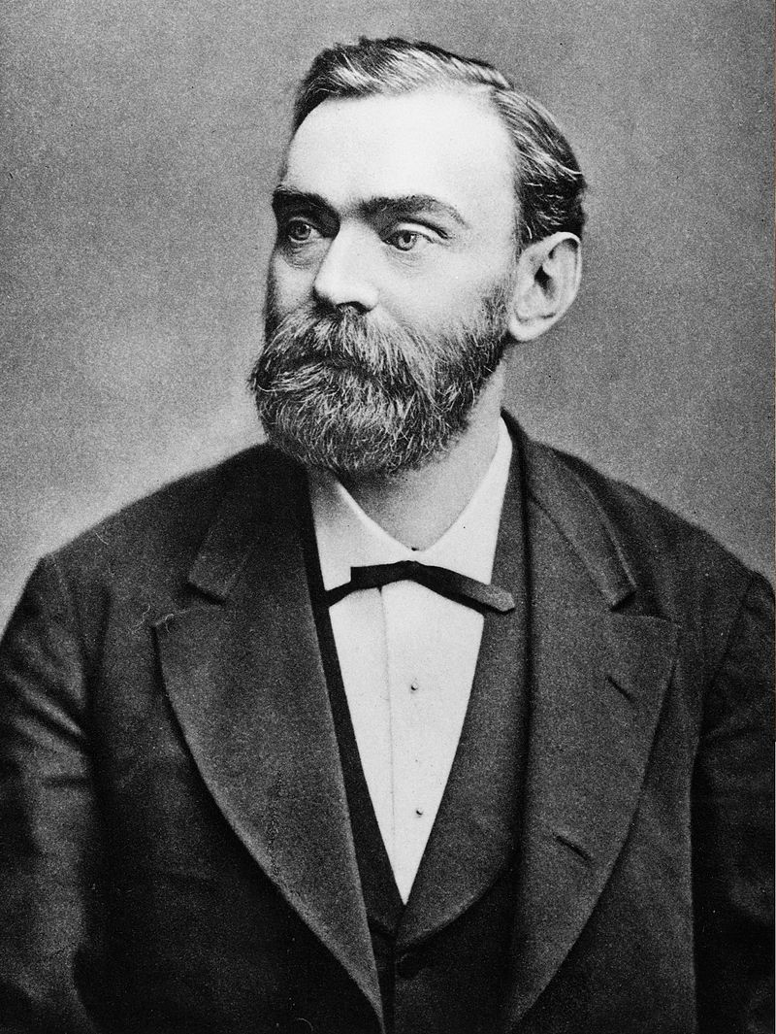
Write your own legacy!
"The merchant of death is dead“
    – Alfred Nobel
    1833 - 1896
Notes:
As we wrap up our discussion, I want to share with you a story that’s very powerful and help you start asking the important question of what is your legacy.
This is the story about Alfred Nobel, for whom the Nobel Prizes are named.
When Alfred Nobel was in the last couple of years of his life, his brother Ludwig died in the south of France.
When Alfred’s brother Ludwig died in 1888, a French newspaper mistakenly published Alfred’s obituary. Reading his own obituary Nobel was disgusted to find out his public image. The newspaper condemned Nobel for inventing dynamite, giving him the infamous nickname “The merchant of death is dead” and went on to say “Dr. Alfred Nobel, who became rich by finding ways to kill more people faster than ever before, died yesterday.”
To Alfred, this obituary was a warning. He spent his lifetime inventing things and had more than 300 international patents, one of which was for dynamite. Reading this, he realized that he was going to be remembered for this one invention versus all of the other good that he had done in the world and he wanted to change that.
This unfortunate event inspired him to make alterations in his will, to improve his public image, and to be remembered for a good cause. He ended up shifting the bulk of his estate to establish the Nobel Foundation and fund the Nobel Prizes.
All of us have the opportunity to determine our legacy, how we want to be remembered, what people say about us by being more conscious in how we complete the important documents and in the conversations they have about them.

Slide 26
Thank You!
Notes:
I hope that today’s presentation has inspired you to act.
I hope that none of you will make the mistake of:
1. Procrastinating or not understanding the gravity of not having Wills and POAs.
2. Waiting for a catastrophic event like illness, death or divorce to get the ball rolling
3. Having the documents, but not taking the time to have the essential conversations with your family
4. Choosing executor that is not up for the task
Thank you for your time and attention. You’ve been a great audience and I hope you have found this presentation informative and motivational to establish a well thought out estate plan to provide you with peace of mind that your estate planning intentions are fulfilled and that you leave a lasting and memorable legacy.
I would be happy to take any questions or comments you may have?

Slide 27
Disclosure
BMO Global Asset Management is the brand name for various affiliated entities of BMO Financial Group that provide investment management and trust and custody services. Certain of the products and services offered under the brand name BMO Global Asset Management are designed specifically for various categories of investors in a number of different countries and regions and may not be available to all investors. Products and services are only offered to such investors in those countries and regions in accordance with applicable laws and regulations. BMO Financial Group is a service mark of Bank of Montreal (BMO).
BMO Global Asset Management is a brand name that comprises BMO Asset Management Inc., BMO Investments Inc., BMO Asset Management Corp., BMO Asset Management Limited and BMO’s specialized investment management firms.
This presentation is for educational purposes only and does not constitute investment, legal, accounting, tax advice or a recommendation to buy, sell or hold a security. It is only intended for the audience to whom it has been distributed and may not be reproduced or redistributed without the consent of BMO Global Asset Management

